Slide 1

Optimized Airline Reservation System Using Hash Table and Sorting Algorithms
PRESENTED BY:
B .Guna Vardhan(AP23110010744) S .V .Kartheek (AP23110010750)
O .V .S .Sumanth (AP23110010786)
S. Yaswanth(AP23110010745)

Slide 2

Introduction
Overview of the Project:
This project focuses on developing an optimized airline reservation system that
efficiently manages flight schedules, seat reservations, and pricing.
It leverages data structures (hash tables) for real-time seat management and sorting
algorithms to prioritize flight options by price.
Objective:
To create a user-friendly system that simplifies airline booking processes, provides accurate seat availability, and presents affordable options to enhance customer satisfaction.

Slide 3

Module Organization
Project Structure:
The system is divided into key modules for efficient management:
Flight Schedule Display: Manages and displays flight information from data files.
Reservation and Booking Management: Handles reservation inputs and stores booking data.
Passenger and Seat Data Handling: Manages passenger details and seat availability using a hash table.
Billing: Calculates total fare based on destination and passenger count.
Seat Availability Reporting: Provides real-time updates on available seats.
Purpose of Each Module:
Each module has a distinct role that contributes to streamlining the reservation process,
ensuring efficient seat management, accurate billing, and real-time updates on seating options.

Slide 4

Module Implementation
Module Implementation
Hash Table for Seat Management
Implements an unordered map for efficient seat tracking.
Allows fast seat lookups and updates, ensuring no double-booking.
2. Sorting Algorithm for Flight Price Ordering
Quick sort
Displays affordable flights first, improving the user selection experience.

Slide 5

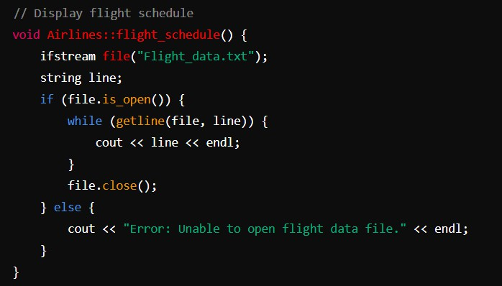
Explanation of modules
Flight Schedule Display
Reads and displays flight details from a file.
Provides users with a sorted list of flights based on price.

Slide 6

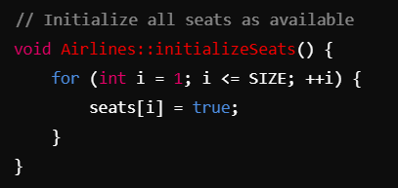
Seat Management with Hash Table
Uses a hash table to efficiently manage seat availability.
Ensures quick lookups and real-time updates to prevent double- booking.

Slide 7
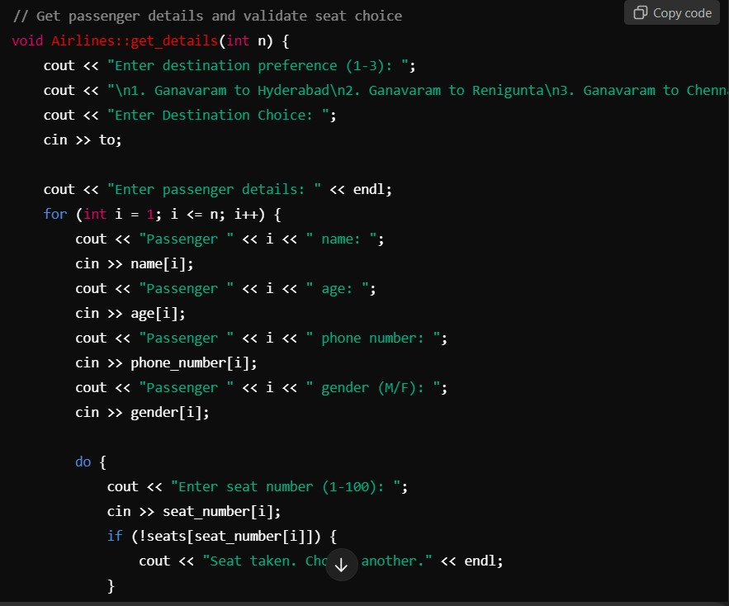
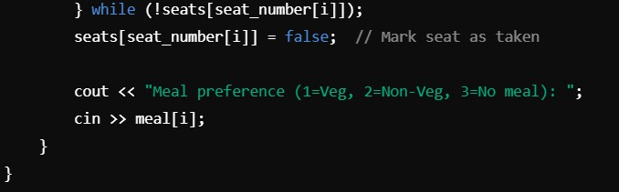
3. Reservation Details Input
Collects and validates passenger details, including seat and meal preferences. Verifies seat availability before confirming reservations.

Slide 8

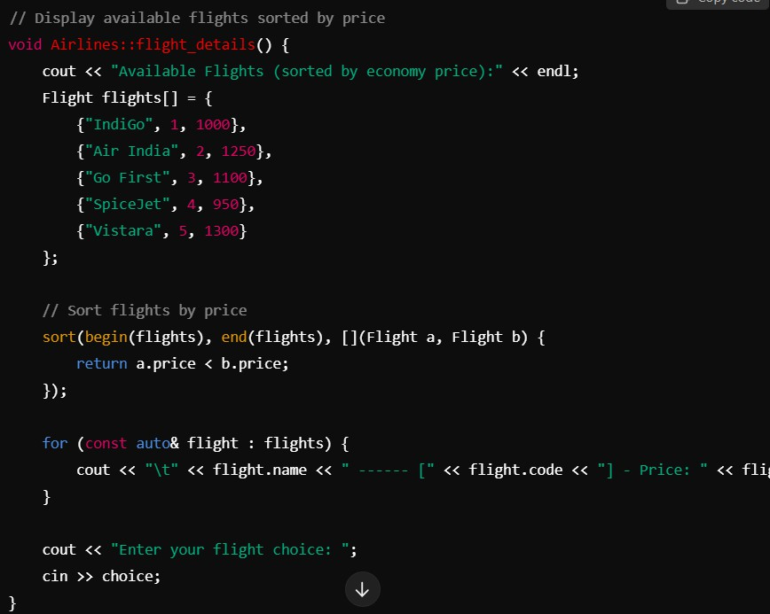
Sorting Flights by Price
Implements std::sort to order flights by economy price.
Enhances user experience by highlighting the most affordable options first

Slide 9

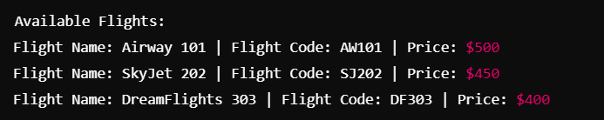
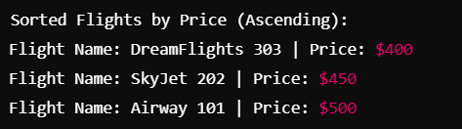
Appendix:
1.Flight Schedule Display Output:
After you run your flight schedule display function your output look like :
2. Flight Sorting by Price Output
After running the sorting functionality, your output will look like:

Slide 10

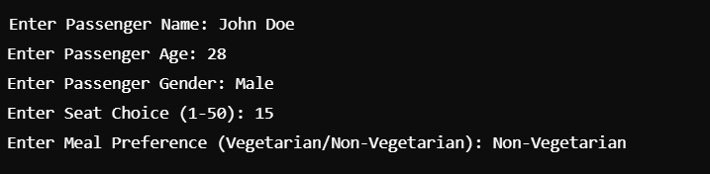
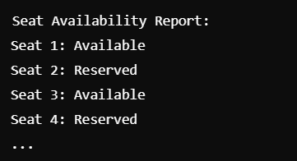
3. Passenger Data Input Output
When the user inputs their data, your output will show prompts like:
4. Seat Availability Output
After running the seat availability reporting function, the output will look like:

Slide 11

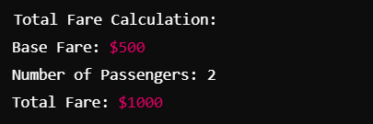
5. Billing and Fare Calculation Output
After calculating the fare based on the chosen destination and number of passengers, you will see an output like:

Slide 12

Conclusion
Summary of System Efficiency
The optimized airline reservation system efficiently handles flight data, seat management, and billing.
Utilizes hash tables for real-time seat availability checks and sorting algorithms for cost-effective flight display.
Potential Future Enhancements
Expand destinations and flight options.
Incorporate dynamic pricing based on demand and real-time seat availability.
Enhance the user interface with visual seat maps for selection.
https://onlinegdb.com/6Kt_9uJN_

Slide 13


